Slide 1

Q-TES: Quantum Traffic Enhancer System
Presented by:
Hasan Abbani¹ - Jimmy Jokhadar¹ - Ola Sadek¹ Roni Trad¹ - Salma Abou Said²
¹GPCS, American University of Beirut
²ECE, American University of Beirut

Slide 2
The Urgent Call for Sustainable Development
In 2015, the United Nations adopted the 17 Sustainable Development Goals (SDGs) as a blueprint for a better future.
These goals address the world’s most pressing challenges: poverty, inequality, climate change, urban growth, and more.
Our modern cities lie at the heart of these challenges — and solutions.

Slide 3
The Urgent Call for Sustainable Development
City traffic being a major point that interwind all of the following Sustainable development Goals:
SDG 3: Good Health and Well-being SDG9: Industry, Innovation, and Infrastructure SDG11: Sustainable Cities and Communities | SDG12: Responsible Consumption and Production SDG 13: Climate Action SDG 15: Life on Land

Slide 4
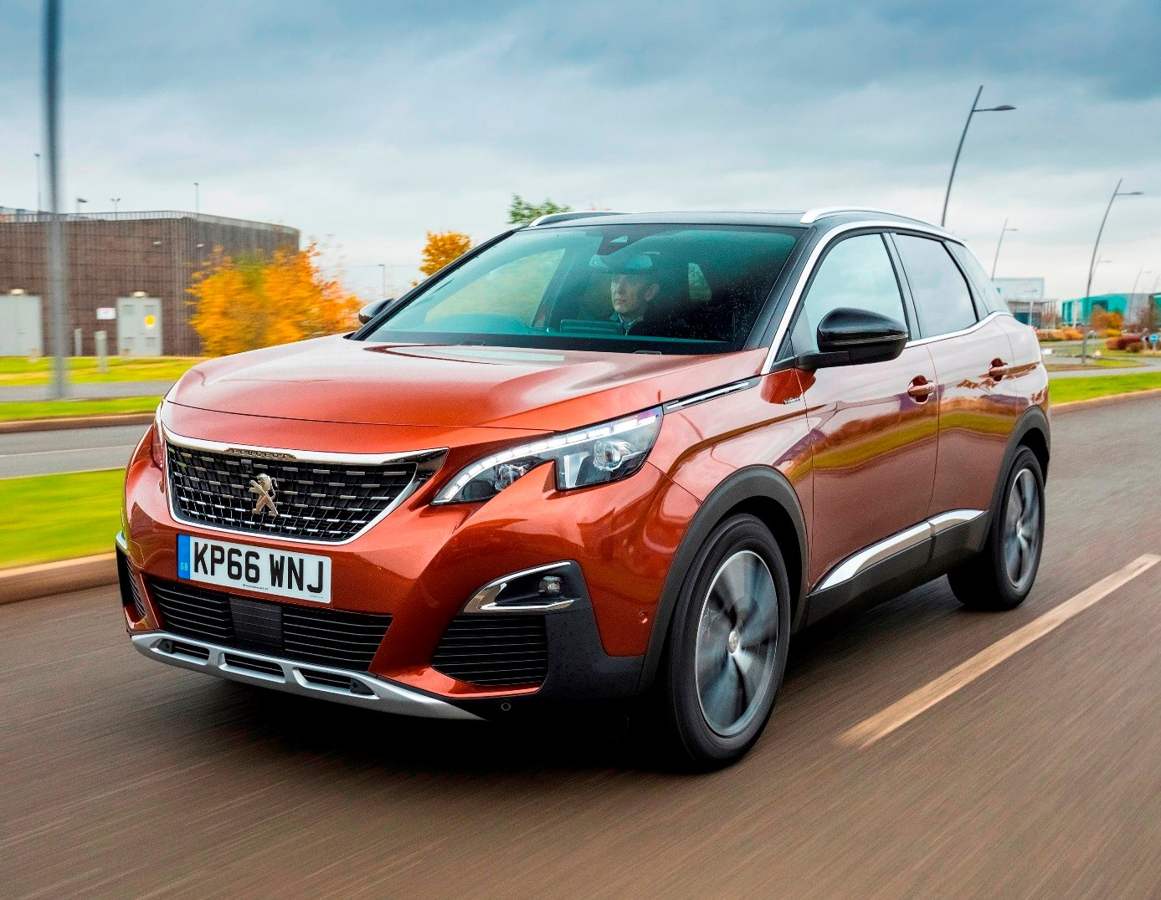
Introduction
Vehicle weight: 1,045 kg
Annual distance travelled: ~11,500 miles
Fuel economy: 22.2 miles/gallon.
→ ~518 gallons/year
Each gallon burned → 8,887 grams of CO₂.
→ Total annual emissions: 4,603 kg of CO₂ /car
3.88 times heavier than the car itself !!!!

Slide 5
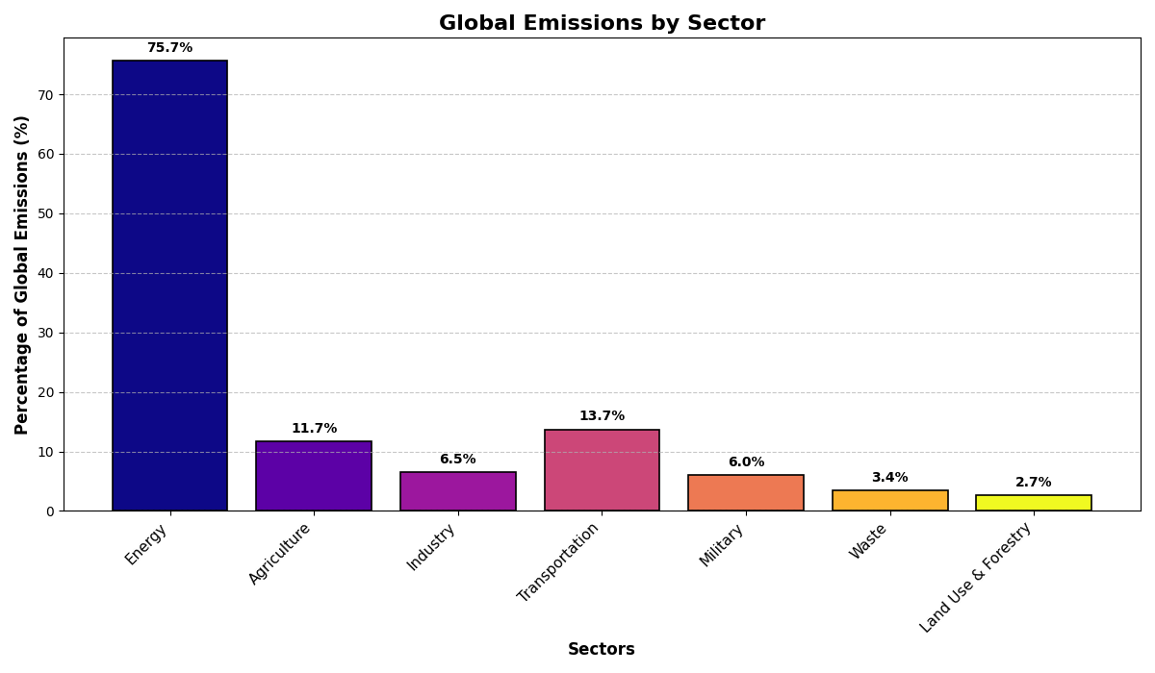
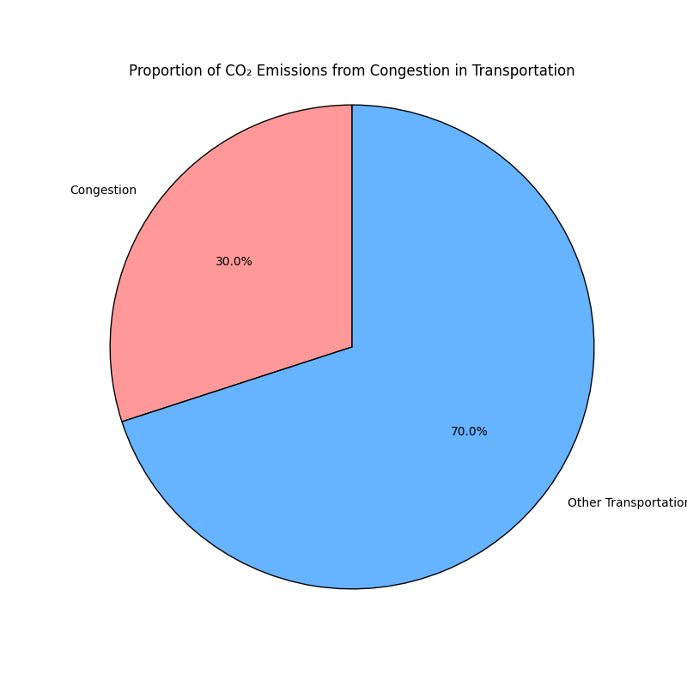
Introduction

Slide 6
Introduction
Our Project Goal
In this project, we aim to model and optimize small traffic networks to:
Reduce CO₂ emissions by minimizing waiting times at intersections.
Improve overall traffic flow efficiency.
The Computational Challenge
Optimizing traffic light schedules is a combinatorial optimization problem.
On large-scale networks, this becomes NP-hard — intractable for classical solvers in real-time.

Slide 7
Why Quantum?
By demonstrating that this problem is solvable on small-scale networks using quantum algorithms,
we build a foundation for scaling to larger networks as quantum hardware matures.

Slide 8
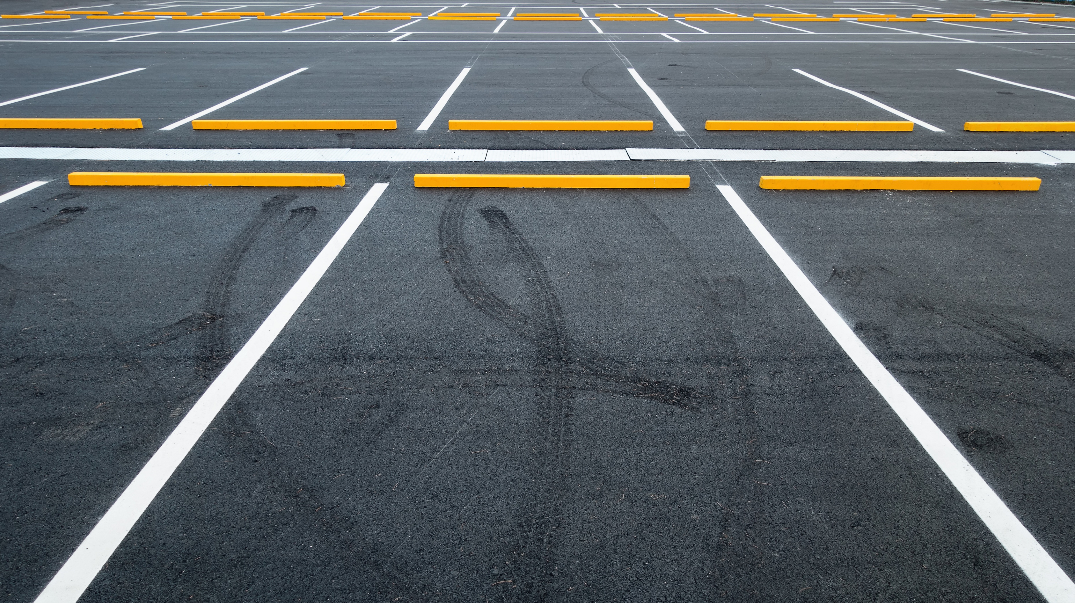
Problem Formulation
Our problem can be formulated as a graph network
Each node represent an intersection with a traffic light
Each edge represents a road
On each edge we can have several cars waiting or transversing the road
Our goal is to optimize the Traffic light at each intersection to minimize the total waiting time

Slide 9













Problem Formulation
$$I_{0}$$
$$I_{1}$$
$$I_{2}$$
$$I_{3}$$
$$I_{4}$$
$$I_{5}$$
$$I_{6}$$
$$I_{7}$$
$$I_{8}$$
$$I_{9}$$
$$I_{10}$$
$$I_{11}$$

Slide 10





Problem Formulation
$$I_{2}$$
$$I_{5}$$
$$I_{6}$$
$$I_{7}$$
$$I_{10}$$

Slide 11

Problem Formulation
Considering working on the node (cross-intersection) i, we have 6 possible modes the cars could take:
$C_{i1}$= number of cars that can pass north-south straight/left during phase 1,
$C_{i2}$= number of cars that can pass east-west straight/left during phase 2,
$C_{i3}$= cars cleared in north right-turn lane,
$C_{i4}$= cars cleared in south right-turn lane,
$C_{i5}$= cars cleared in east right-turn lane,
$C_{i6}$= cars cleared in west right-turn lane.

Slide 12
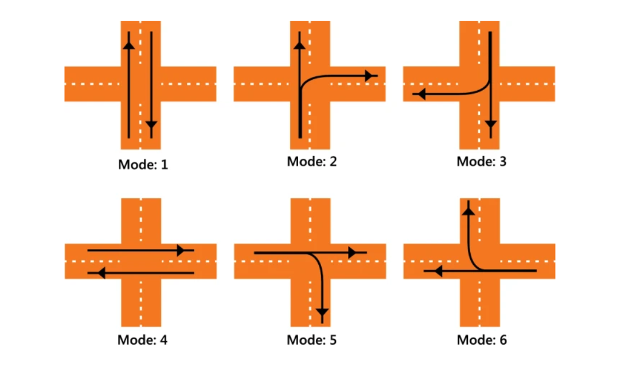





Problem Formulation
$$I_{2}$$
$$I_{5}$$
$$I_{6}$$
$$I_{7}$$
$$I_{10}$$

Slide 13








Problem Formulation
${ω_{i}=ω}_{6}=$ $−\sum_{i=1}^{n}{\sum_{j=1}^{6}{C_{ij}x_{ij}^{2}}}+λ\sum_{i}{{\left(1−x_{ij}\right)}^{2}}$
$$I_{2}$$
$$x_{ij}=\left\{\begin{aligned}1:Option j is chosen at intersection i \\ 0:Otherwise\end{aligned}\right.$$
$$I_{5}$$
$$I_{6}$$
$$I_{7}$$
$$Cij = number of cars cleared$$
$$at intersection i if phase$$
$$timing option j is selected.$$
$$I_{10}$$
$λ$ = Penalty Weight

Slide 14

Problem Formulation
By this we try to m$inimise ω_{i}$ in order to maximize the number of cars cleared by selecting the optimal traffic light configuration $x_{ij}$, which clears $C_{ij}$ cars.
And we introduce a penalty term ${\left(1−x_{ij}\right)}^{2}$to prevent turning multiple traffic lights green if more than one configuration is selected.

Slide 15
Problem Solution
Quantum approximate optimization algorithm can Improve Traffic Flow
We transformed our problem into knapsack where each lane is associated with a weight.
QAOA is best to deal with those combinatorial problems
Why QAOA
Smart Traffic Light Timing:
QAOA helps calculate the best green/red light cycles to reduce waiting times at intersections.
Reducing Congestion:
It analyses multiple routes at once to find the quickest paths for vehicles, preventing jams.
Adapting to Real-Time Traffic:
Unlike fixed schedules, QAOA can adjust signals on the fly based on current traffic conditions.

Slide 16
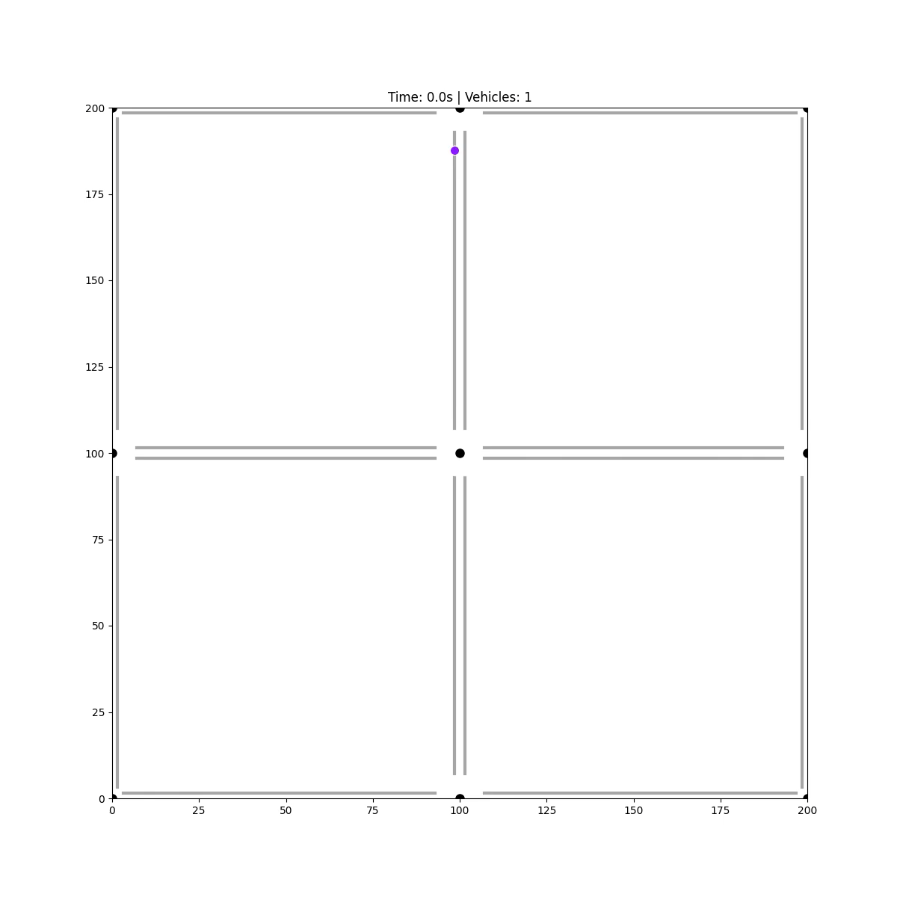

Quantum vs Classical

Slide 17
Conclusion
We modeled and optimized a small-scale traffic network using quantum-based techniques.
Our goal: Minimize waiting times, reduce CO₂ emissions, and improve urban flow efficiency.
This project demonstrates that Quantum Computing can offer feasible solutions to complex optimization problems — even in real-time settings.

Slide 18
Prospects
- Reduction of waiting times for entrance to ERs and operating rooms.
- Rapid product Delivery times.
- Pedestrian & Crowd Management (In Events and Stadiums).
- Air Traffic Control.

Slide 19
Business Model
B2G
subscription service
B2B
subscription service for airlines and event planners

Slide 20
Questions?

Slide 21
THANK YOU FOR YOUR ATTENTION

